Slide 1

Object Oriented Programming with Java (Subject Code: BCS-403)
Unit 1
Lecture 11

Slide 2
Lecture 11
Defining Package
CLASSPATH Setting for Packages

Slide 3
Java Package
Package in Java is a mechanism to encapsulate a group of classes, sub packages and interfaces.
Packages are used for:
Preventing naming conflicts. For example there can be two classes with name Employee in two packages, college.staff.cs.Employee and college.staff.ee.Employee
Making searching/locating and usage of classes, interfaces, enumerations and annotations easier

Slide 4
Providing controlled access: protected and default have package level access control.
A protected member is accessible by classes in the same package and its subclasses.
A default member (without any access specifier) is accessible by classes in the same package only.
Packages can be considered as data encapsulation (or data-hiding).

Slide 5
Advantage of Java Package
1) Java package is used to categorize the classes and interfaces so that they can be easily maintained.
2) Java package provides access protection.
3) Java package removes naming collision.

Slide 6
How packages work
Package names and directory structure are closely related.
For example if a package name is college.staff.cs, then there are three directories, college, staff and cs such that cs is present in staff and staff is present inside college.
Also, the directory college is accessible through CLASSPATH variable, i.e., path of parent directory of college is present in CLASSPATH. The idea is to make sure that classes are easy to locate

Slide 7
Sub packages
Packages that are inside another package are the sub packages.
These are not imported by default, they have to imported explicitly.
Also, members of a sub package have no access privileges, i.e., they are considered as different package for protected and default access specifiers.
Example :
import java.util.*;
util is a subpackage created inside java package.

Slide 8
Accessing classes inside a package
import the Vector class from util package.
import java.util.vector;
// import all the classes from util package
import java.util.*;

Slide 9
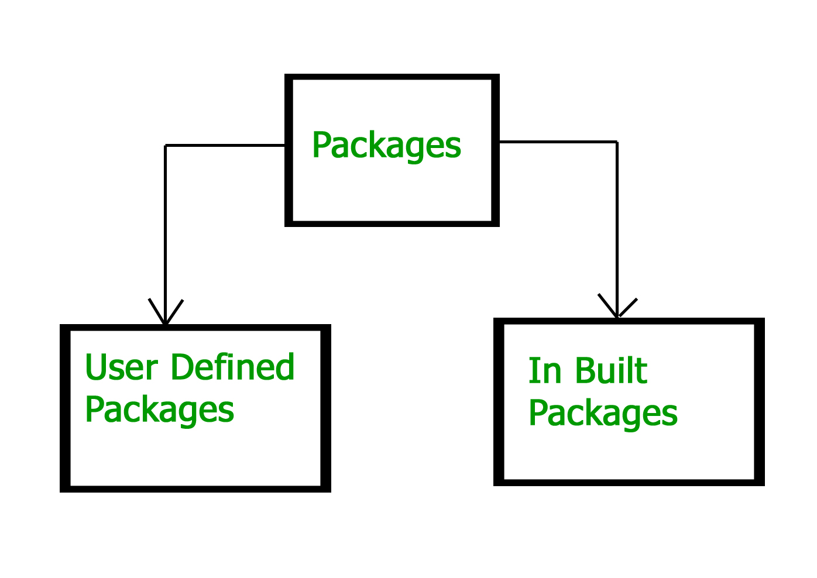
Types of Packages

Slide 10
Built-in Packages
These packages consist of a large number of classes which are a part of Java API.Some of the commonly used built-in packages are:
1) java.lang: Contains language support classes(e.g classed which defines primitive data types, math operations). This package is automatically imported.
2) java.io: Contains classed for supporting input / output operations.
3) java.util: Contains utility classes which implement data structures like Linked List, Dictionary and support ; for Date / Time operations.
4) java.applet: Contains classes for creating Applets.
5) java.awt: Contain classes for implementing the components for graphical user interfaces (like button , ;menus etc).
6) java.net: Contain classes for supporting networking operations.

Slide 11
User-defined packages
These are the packages that are defined by the user.
First we create a directory myPackage (name should be same as the name of the package).
Then create the MyClass inside the directory with the first statement being the package names.

Slide 12
// Name of the package must be same as the directory
// under which this file is saved
package myPackage;
public class MyClass
{
public void getNames(String s)
{
System.out.println(s);
}
}

Slide 13
import myPackage.MyClass;
public class PrintName
{
public static void main(String args[])
{
// Initializing the String variable
// with a value
String name = “ABES Engineering College";
// Creating an instance of class MyClass in
// the package.
MyClass obj = new MyClass();
obj.getNames(name);
}
}

Slide 14
There are three ways to access the package from outside the package.
import package.*;
import package.classname;
fully qualified name.

Slide 15
1) Using packagename.*
If you use package.* then all the classes and interfaces of this package will be accessible but not subpackages.
//save by A.java
package pack;
public class A{
public void msg(){System.out.println("Hello");}
}
//save by B.java
package mypack;
import pack.*;
class B{
public static void main(String args[]){
A obj = new A();
obj.msg();
} }

Slide 16
2) Using packagename.classname
If you import package.classname then only declared class of this package will be accessible.
//save by A.java
package pack;
public class A{
public void msg(){System.out.println("Hello");}
}
//save by B.java
package mypack;
import pack.A;
class B{
public static void main(String args[]){
A obj = new A();
obj.msg();
}
}

Slide 17
3) Using fully qualified name
If you use fully qualified name then only declared class of this package will be accessible.
Now there is no need to import.
But you need to use fully qualified name every time when you are accessing the class or interface.

Slide 18
//save by A.java
package pack;
public class A{
public void msg(){System.out.println("Hello");}
}
//save by B.java
package mypack;
class B{
public static void main(String args[]){
pack.A obj = new pack.A();//using fully qualified name
obj.msg();
}
}

Slide 19
Setting CLASSPATH
CLASSPATH can be set by any of the following ways:
CLASSPATH can be set permanently in the environment: In Windows.
CLASSPATH can be set temporarily for that particular CMD shell session by issuing the following command:
> SET CLASSPATH=.;c:\javaproject\classes;d:\tomcat\lib\servlet-api.jar

